Slide 1


Slide 2
Introduction To Redis
Redis is an open source (BSD licensed), in-memory data structure store, used as a database, cache and message broker. It supports data structures such as strings, hashes, lists, sets, sorted sets with range queries, bitmaps, hyperloglogs, geospatial indexes with radius queries and streams.

Slide 3
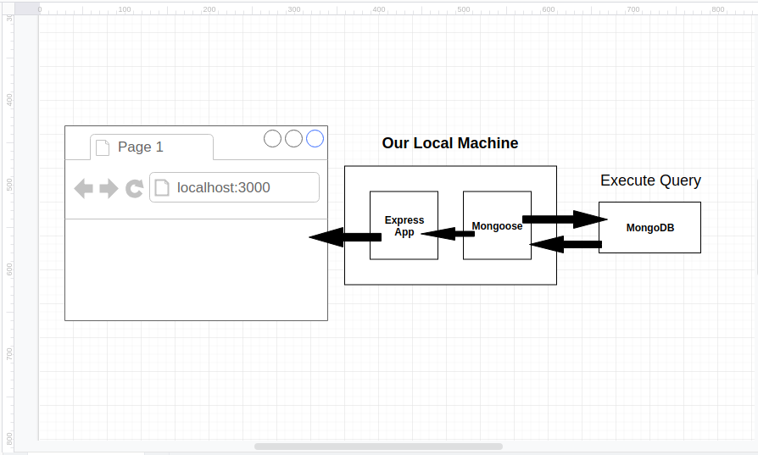

Slide 4
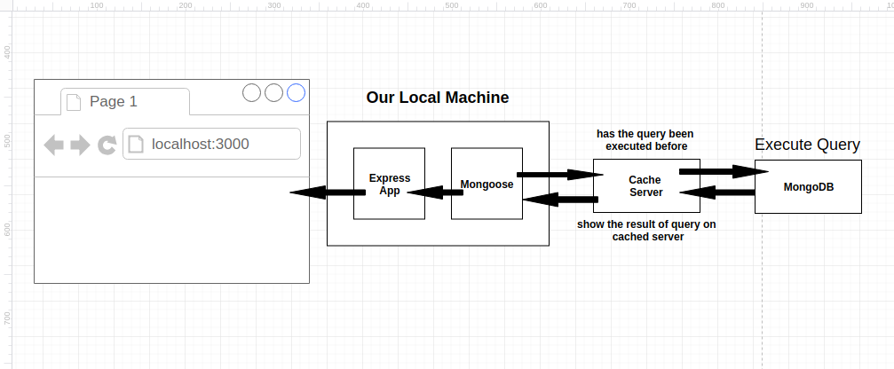

Slide 5
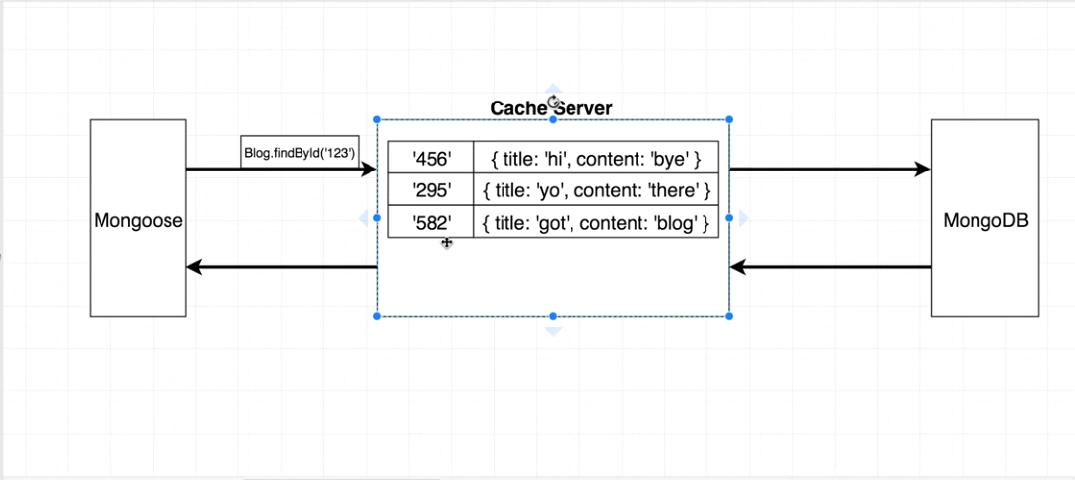
.

Slide 6
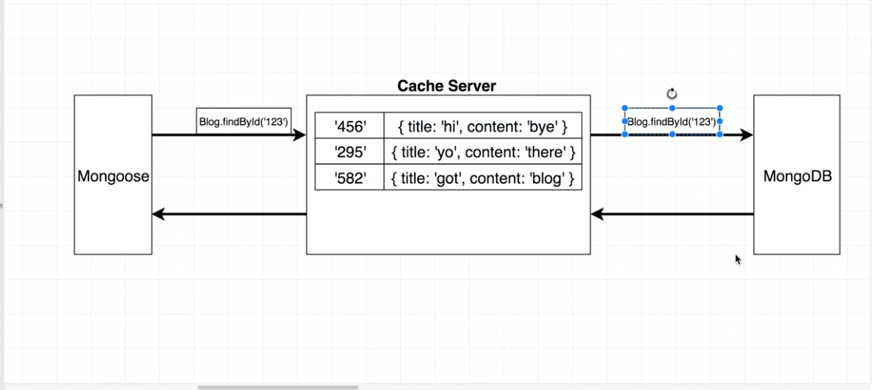

Slide 7
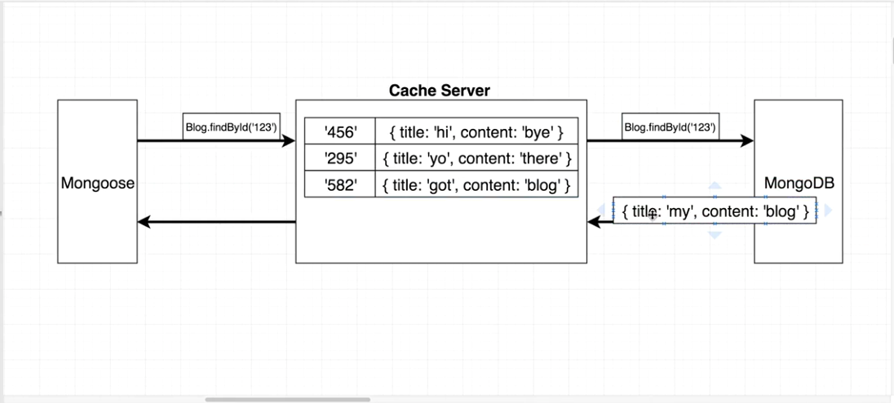

Slide 8
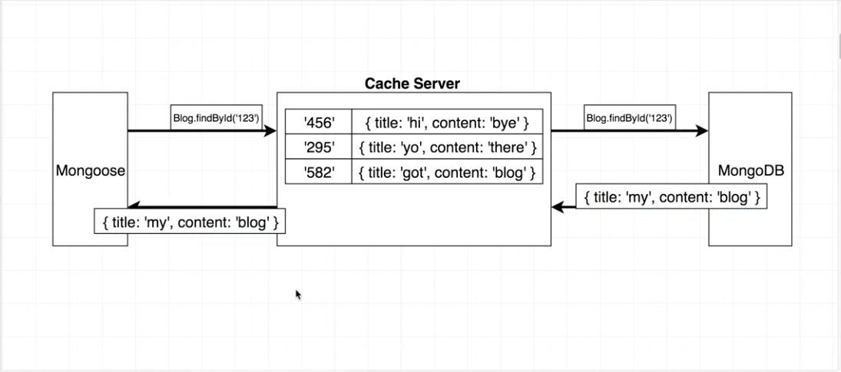

Slide 9
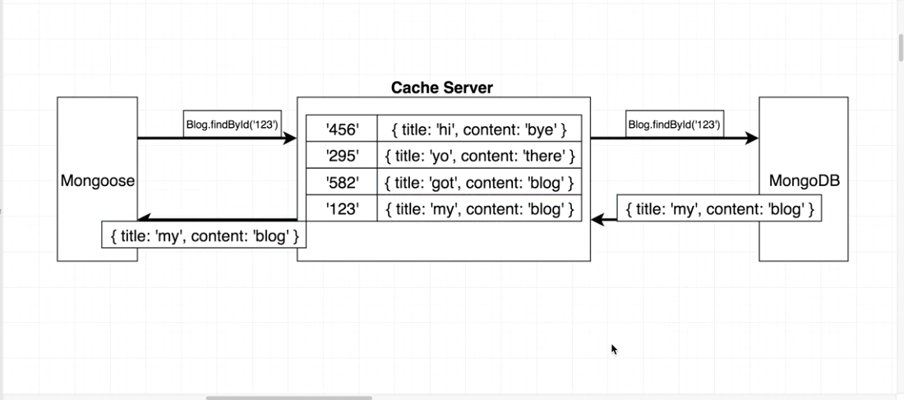

Slide 10
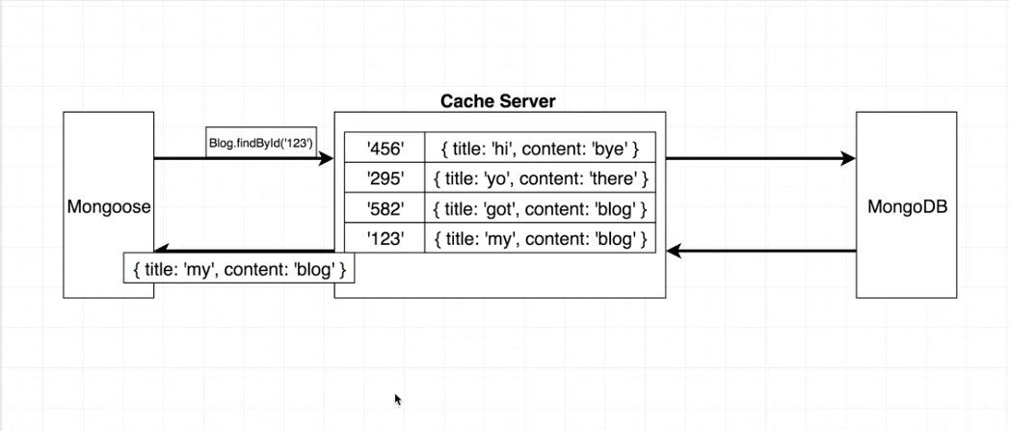

Slide 11
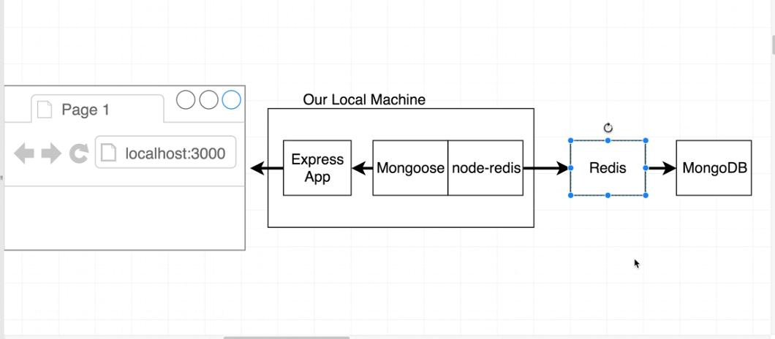

Slide 12
Redis installation
Install node-redis client for nodejs Project:
> npm install redis Install Redis Server:
Start and stop a local Redis server in Node.js like a boss. > npm install redis-server

Slide 13
Usage Of Redis:
> Redis Configuration :
const redis = require('redis');
const redisUrl = 'redis://127.0.0.1:6379'; >This is the by default redis url and port no const client = redis.createClient(redisUrl);

Slide 14
Client.on() Redis Event Emitter:
RedisClient Provide .on() EventEmitter to validate connection to redis server:
1 .on(‘connect ’, ( ) =>{ } ) This event called when our server connected to redis server 2 .on (‘error’ , err=>{ } ) This event called when our server not connected to redis server and It give’s error in callback function

Slide 15
Example :
// connection to redis:
client.on('connect', () => { console.log(`connected to redis`); });
client.on('error', err => { console.log(`Error: ${err}`); });

Slide 16
Redis Set and Get Handlers:
Redis store data in key:value pairs like and object store literals:
Key : key is the name of the property that you want to save into Redis server >> Note : key should be unique so that it won’t overlap and create conflicts with another keys Value :this is the value which map into the defined key (name) above

Slide 17
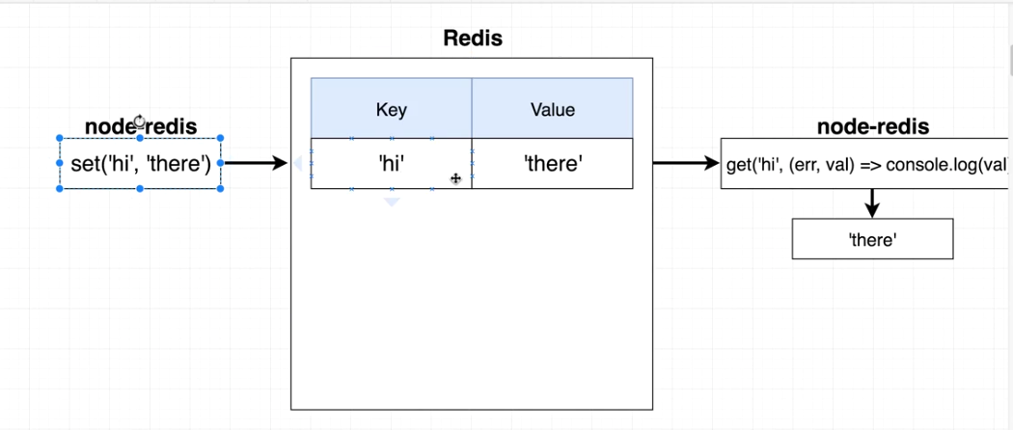
Redis Getter and Setter Handlers E.g:

Slide 18
Code for get and set into redis:
By default Get and Set functions are synchronous to make them async we have to user ‘util’ library which is given by node by default :
Example:
>> const utilPkg = require('util'); >> client.get = utilPkg.promisify(client.get);

Slide 19
Code Example of Get and Set:
const cachedValue = await client.get(key); if (cachedValue) { console.log(" IN IF! FETCHED DATA FROM REDIS CACHED SERVER") console.log("cachedValue", cachedValue); }else{ // do some API calling fetched some data. client.set(key, JSON.stringify(data), 'EX', 86400) }

Slide 20
Redis Clear Cache ( Using Cli ) :
There are 2 way to clear cached data:
Method #1 (Using Redis Cli) :
One command to clear whole Redis server: Steps:
Goto Redis cli by typing “redis-cli”.
flushall (to clear all cached data)

Slide 21
Redis Clear Cache ( Using Redis Query ):
Method #2 (Using Redis Query) :
Query:
client.DEL(keyname, callback)

Slide 22
Thank You That’s All for 20 Minutes ;)

